Slide 1
Sanskriti Vini
Indian Virtual Heritage

Slide 2
ABOUT OUR IDEA
Overview of Idea
Sanskriti Tours is a Virtual Heritage tour to explore the culture and history of our motherland. Using Virtual reality (VR) we want to provide a virtual and exotic experience to virtual tourists with interactive features and a user-friendly interface with different Indian languages.

Slide 3
ABOUT OUR IDEA
Your Approach towards Idea Development
The application includes 360-degree VR images, videos and simulated animations of each of the historical structures and atmosphere.
Virtual Reality headsets can be used as a tool to perceive the monuments and the virtual environment.
With help of this application, students and adults can understand the history of the place in any of the given Indian languages.

Slide 4
ABOUT OUR IDEA
How we intend to develop it:
We will list out the places we wish to show on our tours.
We will collect the information about that place from the Internet which we will create into text files which can be also used as subtitles.
We will create audio files in various languages using the same text
We will collect videos or make videos of those places to make it feel like we are walking through that place.
We will design a train on Photoshop or any other 2D/3D editors if possible to make it look like we are travelling on a train to different places.
We will use AR/VR technology to integrate everything together. We need to explore how to use it to achieve our idea.
We also intend to create a person who will be seen in the side of the screen to make it look like a virtual tour guide is taking us around the place.
If they use VR headsets it will feel like they are in that place, so we want to explore those areas also.

Slide 5
How this idea is different from existing ideas
Usually in Social Studies period in school, teachers use only the atlas and pictures and videos to show the places of importance.
The school usually will organize a educational tour to some important places. But students who can’t afford to go on such a trip miss out on the experience.
So we want to develop our idea that everyone can experience going to that place without having to leave their home.
Also we thought of this idea during this pandemic, we missed the field trips and everything was online, so this idea was perfect for situations like this when we can’t travel.

Slide 6
HARDWARE AND SOFTWARE USED
Hardware:
A decent laptop for designing and coding
Software:
Unity
C#

Slide 7
MODULES
Site Selection Scene
Language Select Scene
Virtual Viewer Scene

Slide 8
What is missing? What we wish to make
Google Earth has 3D images for other places in other countries like France (Eiffel Tour), Italy (Colosseum), etc but in India very few places have been developed in 3D.
British Museum, Louvre Museum also had virtual tours which we got to see in our online classes so we wanted to make one for India since we don’t have anything like that for India.
People will be able to visit many places and learn about it in their own language without spending money and travelling.

Slide 9
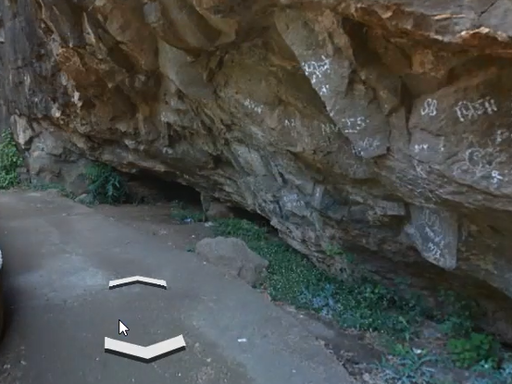
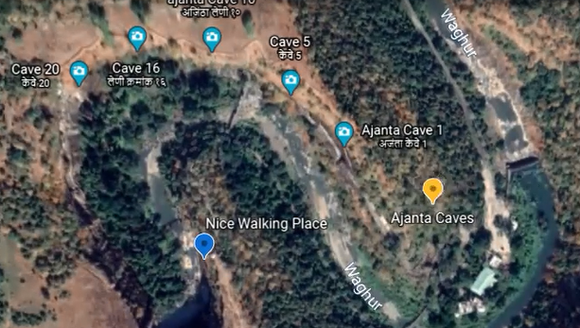
Images about our product idea

Slide 10
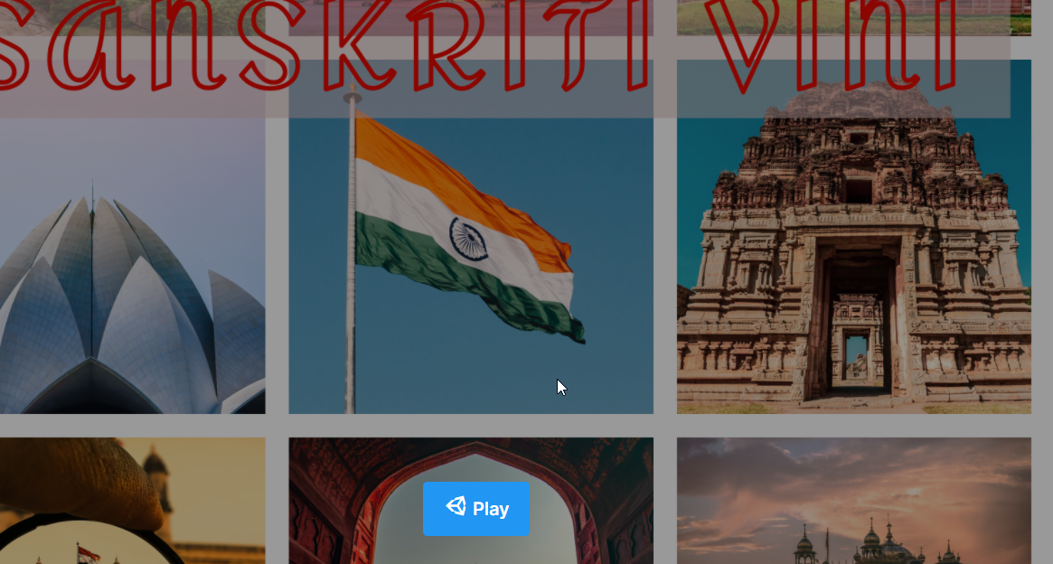
App Demo

Slide 11
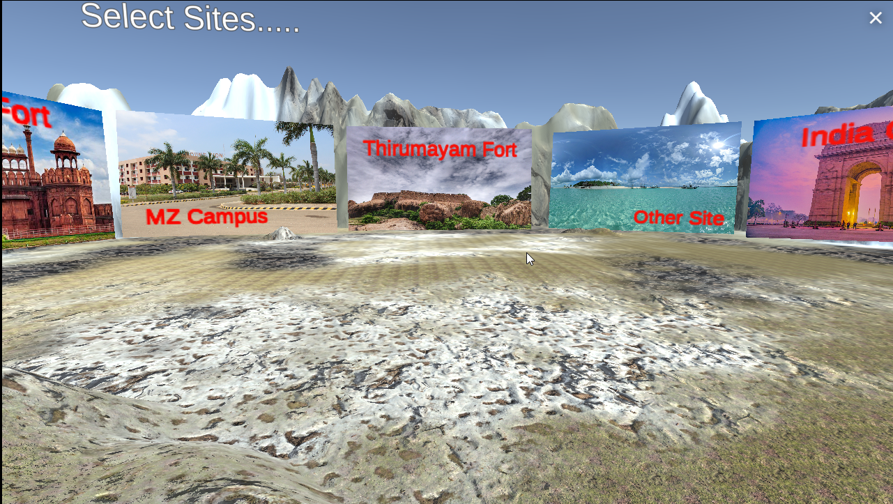
App Demo

Slide 12
Conclusion
Using this technology we can go anywhere in the globe without going out of our houses. We can have the best experience out of it. Thereby keeping us safe and updated.

